Slide 1
Split Bills
Guided by E.Shailaja
Vamsi Krishna Desineedi
Rithi bhamidipati

Slide 2
CONTENTS
What is Split Bills?
Existing work
Comparing Existing work and Split Bills
Conclusion
References

Slide 3

What is split bills
Split bills is a financial management system that helps groups to easily share and track expenses.
This allows users to create a group and add expenses, which are then used to calculate the amount that each member owes.
Splitbills is a useful tool for anyone looking to keep track of shared expenses and payments in an organized and efficient way.

Slide 4

Existing work
Group Expenses
Receipt Scanning
Payment Tracking
Payment Options
Personal Finance Tracking

Slide 5

Are you ready
To see How much you owe your friend?

Slide 6

Consider a situation
Friends | Event 1 | Event 2 | Event 3
Rithi
Vamsi
Amogha
Spoorthi
Gowthika
*
500
*
*
*
*
*
*
700
*
*
*
*
400

Slide 7
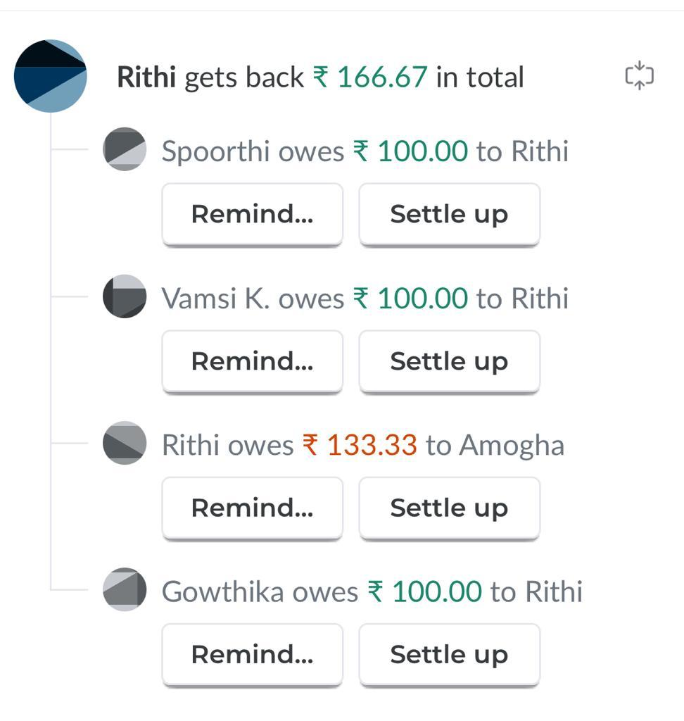
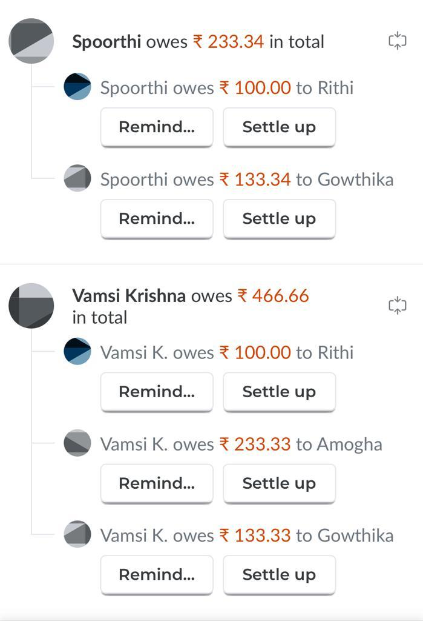
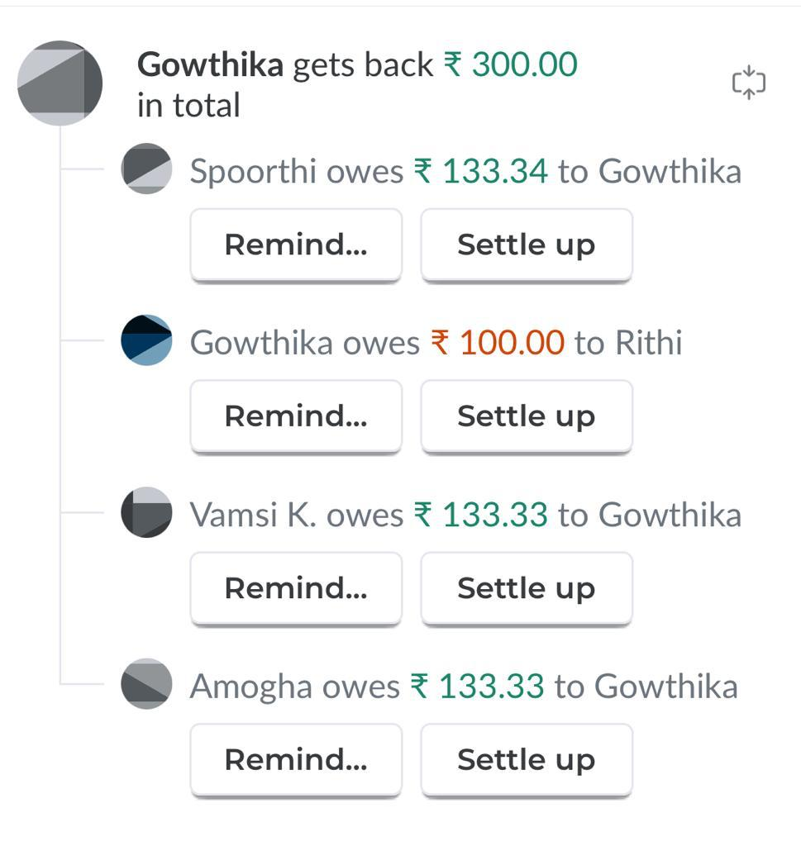
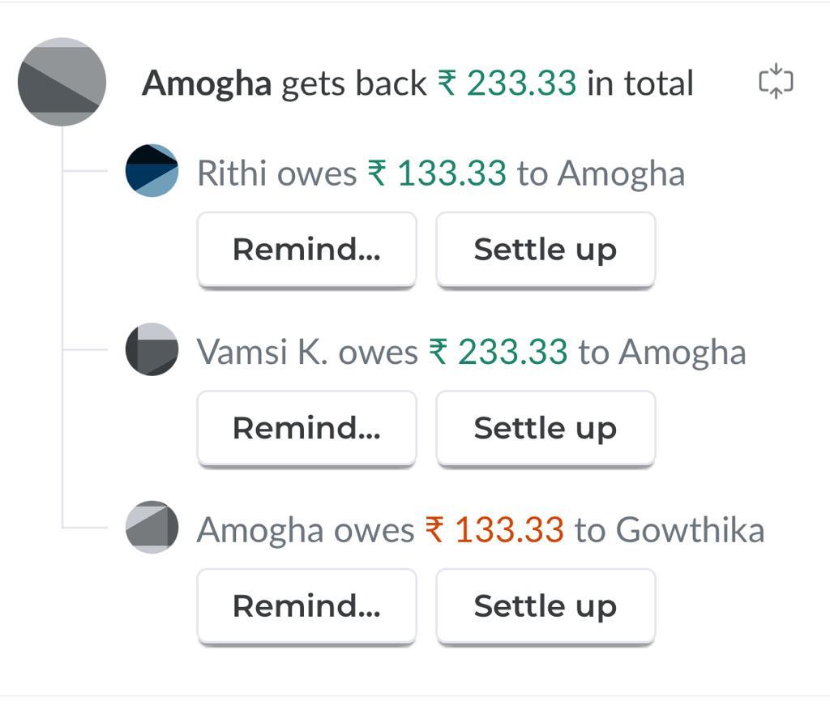
Splitwise vs

Slide 8
Vs split bills
Rithi:-
Vamsi has to pay 166.66 to Rithi
2. Vamsi:-
Rithi will receive 166.66 from Vamsi
Amogha will receive 233.33 from Vamsi
Gowthika will receive 66.66 from Vamsi
3. Amogha:-
Vamsi has to pay 233.33 to Amogha
4. Spoorthi:-
Gowthika will receive 233.33 from Spoorthi
5. Gowthika:-
Vamsi has to pay 66.66 to Gowthika
Spoorthi has to pay 233.33to Gowthika

Slide 9
conclusion
• Hence, we have successfully developed Split Bills using Java.
• Further, we can also try to add some more features to this project such as an option for receipt Scanning and Personal Finance Tracking.
• Through this project we learned how to use Java in real-life applications.
• A feature of Personal Tracking.
• Option to view the history of expenses and debts.
• Option to connect with a bank account and track expenses automatically.

Slide 10
references
https://www.youtube.com/watch?v=EnaIWAitmEU
https://www.geeksforgeeks.org/
https://www.tutorialspoint.com/java/index.htm
Splitwise app

Slide 11
Thank You

